Slide 1
Preview email
<p>Good morning,</p>
<p>This week we will be discussing analysis of <a href="https://en.wikipedia.org/wiki/Time_series">time series data</a>. Data that is indexed by a timestamp is extremely prevalent.</p>
<p>Techniques used frequently for analysis include the <a href="https://en.wikipedia.org/wiki/Fourier_transform ">Fourier transform</a> and linear regression (see chapter 3 in <a href="http://faculty.marshall.usc.edu/gareth-james/ISL/ISLR%20Seventh%20Printing.pdf">An introduction to Statistical Learning</a>). Additional (optional) reading is available on the <a href="https://priceonomics.com/the-discovery-of-statistical-regression/">history of regression and least squares</a>.</p>
<p>John</p>

Slide 2
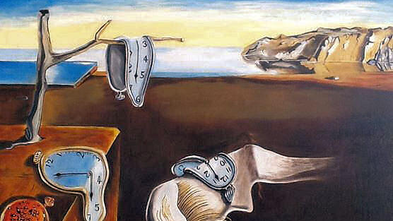
Class 9: Time series and linear regression
Data 601 @ UMBC
These notes are CC BY 4.0
https://en.wikipedia.org/wiki/The_Persistence_of_Memory
Notes:
https://en.wikipedia.org/wiki/Time_series
http://strftime.org/
https://www.google.com/search?q=sas+time+series+analysis
https://www.google.com/search?q=sas+time+series+forecasting

Slide 3
Review of power data; dice roll notebooks

Slide 4
Activity: randomly-selected presenter
Pick a student using select_random_student.ipynb
Student presents their dice assignment
Pick a student using select_random_student.ipynb
Student presents their power analysis assignment

Slide 5
Activity: code review
Find a partner with who you haven't collaborated with recently
Tell your partner what you learned last week
Read your partner's code line by line. Your role of peer-reviewer is a reader, not an evaluator.
Code author: Explain to your partner what each line in code does

Slide 6

Course schedule and outline (scope)
1: Overview of Data Science
2: Python in Jupyter
3: Getting data
4: Data cleanup
5: Automation; Reports
6: Project 1 presentations
7: Math
8: time series
: Clustering
: Project 2 – reproducibility
: Elasticity, Cost/Benefit
: Property graphs
: Scaling up
: Final project presentations

Slide 7
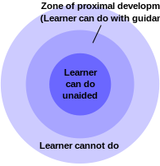
Project 2
Data resources
Rubric for proposal
Rubric for project
Desired outcome is 😲
"the role of education is to give students experiences that are within their zones of proximal development, thereby encouraging and advancing their individual learning such as skills and strategies."
Notes:
https://en.wikipedia.org/wiki/Zone_of_proximal_development

Slide 8

Outcomes for this evening
By the end of today's class, you should be able to answer the following:
How do decompose time series into trends and seasonality
How to use Linear Regression for trend analysis
How Fourier Transform helps determine seasonality

Slide 9
Courses offering full semester on time series
ECON 423
STAT 417
STAT 617
Time Series and Forecasting: Study of the application of economic statistics to forecasting problems. Topics covered include analysis of cross- section and time-series data, use of published economic indicator series and forecasting methodology.
Introduction to Time Series Data Analysis: Concepts in time series analysis, such as stationarity; some commonly used time series models, such as autoregressive moving average models, are introduced using examples. Time series data analysis tools, namely, auto-correlation function (ACF), partial autocorrelation function (PACF), detrending, differencing and forecasting will be discussed using real data sets. Some selected topics from time series modeling, such as transfer function models and intervention models, will be discussed. Data analysis using statistical software such as SPLUS will be an integral part of the course.
Time Series Analysis: Theory and applications of time series models, auto-regressive integrated models, Box-Jenkins methodology, forecasting, seasonal models and their applications, spectral theory and estimation of time series models and time series data analysis using statistical packages.

Slide 10
What is time stamped data?
What is time stamped data?
Why does time stamped data matter?
Data cleanup of time series
Time stamps in Python
Visualization
Linear regression for trend analysis
Fourier transform
Homework

Slide 11
Time series
Time | Event
... | ...
date/time | value
…. | ….
A column in a Pandas dataframe is also of type "series"

Slide 12
Time series
Time | Event 1 | Observation | sensor
... | ... | ... | ...
date/time | value | value | value
…. | …. | ... | ...
Hmm, this starts to look like a Pandas dataframe...

Slide 13
Activity: What are examples of time series?
Brainstorm ideas individually, and type them in chat messages
(We will aggregate your ideas in the next phase of the activity.)

Slide 14
What creates time series?
Periodic and ad hoc historical data
Stock market pricing
Conference attendance count
Crop yields
Number of cars on road per year
Physical sensors
Self-driving car: LIDAR
Internet of Things
Medical devices
Industrial control systems
Self-driving cars
Recommendations
Netflix
Youtube

Slide 15
Order distinguishes time series from other data
When flipping a coin and rolling a die, outcomes are not dependent on previous events – the system does not have memory (stateless)
Events in a time series are ordered – shuffling the sequence of events loses information
Demo: order_distinguishes_time_series.ipynb

Slide 16
Filling in missing values
For time series data, using adjacent rows to interpolate may make sense
Dropping data with missing entries should not be the default approach. You could explore the use of error bars in the claims you make about data. If you know that you don't know the specific values, how much uncertainty does that introduce into your claims?
When the order of rows in a dataframe does not matter, then row adjacency-based interpolation may not be the appropriate method to address NaN entries. A way to test whether the analysis outcome depends on row order is to shuffle the order of the rows and re-run analysis.
When interpolation to fill NaN entries is not directly applicable, an indirect method would be to determine clusters of similar rows before interpolating. This would require identifying a metric for how strongly different entities are related.

Slide 17
Why does time stamped data matter?
What is time stamped data?
Why does time stamped data matter?
Data cleanup of time series
Time stamps in Python
Visualization
Linear regression for trend analysis
Fourier transform
Homework

Slide 18

Why care?
Evolution of sensor values over time can be a story that is useful
Pattern recognition
Anomaly detection
Predictive analysis (extrapolation)

Slide 19
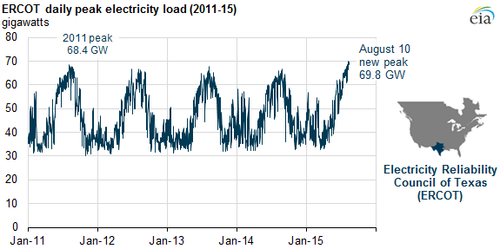
Application: Load forecasting enables resource planning
Example
time series

Slide 20
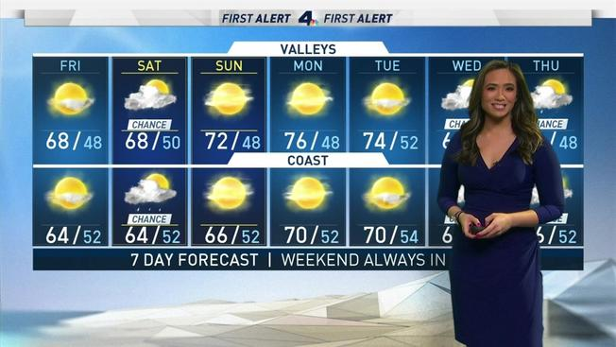
Application: Weather forecasting enables you to make more precise plans for the weekend
Example
time series

Slide 21
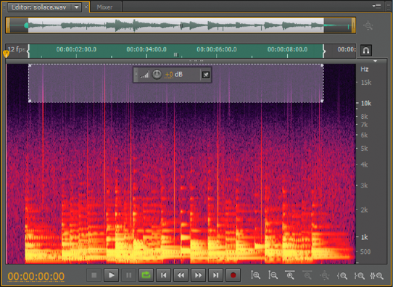
Application: voice recognition software
Example
time series

Slide 22
Common tasks for analysis of time series Independent of the domain of application
Distinguish these aspects in a single time series
Trends
Changes in trends
Periodicity (also known as seasonality)
Noise (also known as residuals)
Anomalies
Averages (aka level)
Once univariate analysis has been accomplished, typically want to combine multiple time series sources (multivariate analysis)

Slide 23
Data cleanup of time series
What is time stamped data?
Why does time stamped data matter?
Data cleanup of time series
Time stamps in Python
Visualization
Linear regression for trend analysis
Fourier transform
Homework

Slide 24

Common data cleanup challenges
For a single data source,
Which time zone?
By how much does the clock drift?
Which time stamp format? See http://strftime.org/
YY-MM-DD or MM-DD or MM-DD-YY ?
What granularity (Year/Month/Day/Hour/Minute/Second)?
Each solution has different constraints and different assumptions
Getting time stamp data

Slide 25
Common data cleanup challenges
Inconsistent formats when combining multiple sources
Same timezone as other sensors? UTC versus local?
Are all clock sources synchronized?
Different software has different default formats for time stamps
Solutions implemented at different times adhere to distinct schemas
Getting time stamp data

Slide 26
Creating a dataframe of time stamped data
Every row is either
a time bin (with start and stop edges)
is the time stamp the start, end, or middle value?
or
an instantaneous value
What if sensor times are not aligned?
How to deal with missing sensor values? Fill in with NaN?

Slide 27
Creating a dataframe of time stamped data
Every row is either
a time bin (with start and stop edges)
is the time stamp the start, end, or middle value?
or
an instantaneous value
What if sensor times are not aligned?
Demo: temporal_anomalies_and_bin_alignment.ipynb

Slide 28
Time stamps in Python
What is time stamped data?
Why does time stamped data matter?
Data cleanup of time series
Time stamps in Python
Visualization
Linear regression for trend analysis
Fourier transform
Homework

Slide 29
Activity: how do you describe now?
In the chat room, type out today's day, date, and time
(We will aggregate your ideas in the next phase of the activity.)

Slide 30
Time stamp formats
Reasons for disparity:
Every vendor has the freedom to choose their own default output
What seems best for human consumption is a subjective choice
Different optimization objectives: compactness versus granularity
Different assumptions or use cases
"users would always use local time zone" or
"users would always use UTC"

Slide 31

You are not the first person to encounter this
Primary library: https://docs.python.org/3/library/datetime.html
Useful reference page: http://strftime.org/
Demo: go to http://strftime.org/
I'll provide an example of strftime in a few slides
Notes:
https://www.quora.com/In-Python-what-is-the-difference-between-strftime-and-strptime

Slide 32
Time is relative: Timezones
Naïve assumption: there are 24 time zones
--> Currently 37 Different Local Times in Use (source: https://www.timeanddate.com/time/current-number-time-zones.html )
Rather than specify "Eastern Time Zone", a common alternative is UTC offset
For example, UTC−05:00 is a time offset that subtracts five hours from Coordinated Universal Time (UTC).
Demo: timezones.ipynb

Slide 33
Time is local: Timezones
Naïve assumption: timezones are static
In North America, UTC-5 is observed in the Eastern Time Zone during standard time, and in the Central Time Zone during the other eight months (see Daylight savings time). Source: https://en.wikipedia.org/wiki/UTC%E2%88%9205:00
Reverse engineering the local time based on a location is susceptible to local exceptions; see https://state.1keydata.com/time-zone-state.php

Slide 34
One solution: use Epoch time
time.time() function returns the number of seconds since the epoch.
"Epoch" is defined as the start of January 1st, 1970 in UTC.
>>> import time >>> print(time.time()) 1355563265.81
This can be converted to a string of your choosing:
>>> import datetime >>> print(datetime.datetime.fromtimestamp(time.time()).strftime('%Y-%m-%d %H:%M:%S'))
2012-12-15 01:21:05
Notes:
https://stackoverflow.com/questions/13890935/does-pythons-time-time-return-the-local-or-utc-timestamp

Slide 35
Visualization
What is time stamped data?
Why does time stamped data matter?
Data cleanup of time series
Time stamps in Python
Visualization
Linear regression for trend analysis
Fourier Transform
Homework

Slide 36
Plotting Time series: x-axis as datetime
Data typically has a column of datetime entries
By default, index in Pandas is integers
Data source: host_streaming_stats/host_cpu_and_memory.ipynb
Demo: plotting_timeseries_data.ipynb
Good overview: https://machinelearningmastery.com/time-series-data-visualization-with-python/

Slide 37
Flat lines and sine waves
https://seaborn.pydata.org/generated/seaborn.lineplot.html#seaborn.lineplot
https://pandas.pydata.org/pandas-docs/stable/user_guide/timeseries.html

Slide 38
Linear regression for trend analysis
What is time stamped data?
Why does time stamped data matter?
Data cleanup of time series
Time stamps in Python
Visualization
Linear regression for trend analysis
Decomposing time series
Fourier transform
Homework

Slide 39
Map of Machine Learning topics
Machine Learning
Supervised
User provides "right answer" as example data
Regression Predict real valued output
Unsupervised No labeled data provided
Classification Predict discrete valued output
Logistic regression
Linear regression
Decision tree
Neural network (DL)
Notes:
See also https://ruda.city/Machine-Learning and https://shibberu.com/2016/04/26/ma-490-deep-learning/

Slide 40
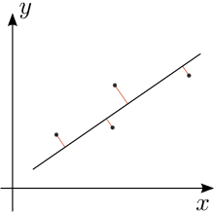
Activity: Draw best fit straight line on plot
Need a volunteer who is not in Data 602
Notes:
On the whiteboard, have an x-y axis with a few points that are roughly linear.
Request that the student draw a line of best fit through the points, then have them explain their reasoning

Slide 41
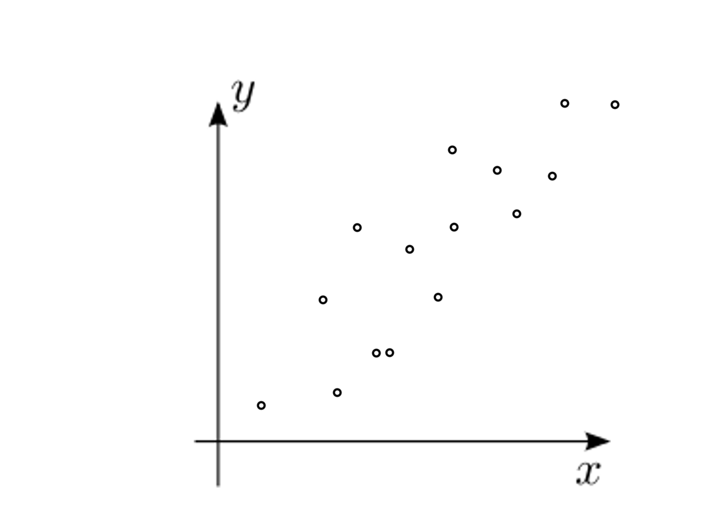

Slide 42
What you (probably) did
If there is uncertainty in both the x and y coordinates, then use an approach which admits variation in both
https://en.wikipedia.org/wiki/Deming_regression
Notes:
https://news.ycombinator.com/item?id=10944831

Slide 43
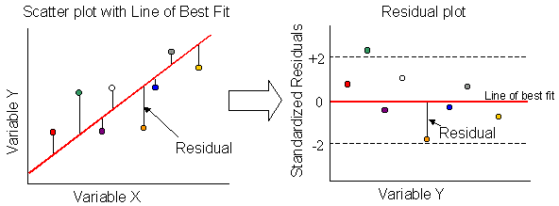
Linear Regression concepts
Predict a target variable by fitting the best linear relationship between the dependent and independent variable.
Y X
The best fit is done by making sure that the sum of all the distances between the shape and the actual observations at each point is as small as possible.
Notes:
http://labs.geog.uvic.ca/geog226/frLab9.html

Slide 44
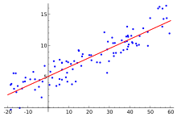
Residual = difference between what the current model gives us and the "right" output
Best approach to minimize the residual depends on your data
ordinary least squares for independent and identically distributed errors
generalized least squares for arbitrary covariance
weighted least squares for heteroskedastic errors
(error in y varies with x)
feasible generalized least squares with autocorrelated errors
(function repeats)
Notes:
https://www.statsmodels.org/stable/regression.html#examples
https://en.wikipedia.org/wiki/Ordinary_least_squares

Slide 45
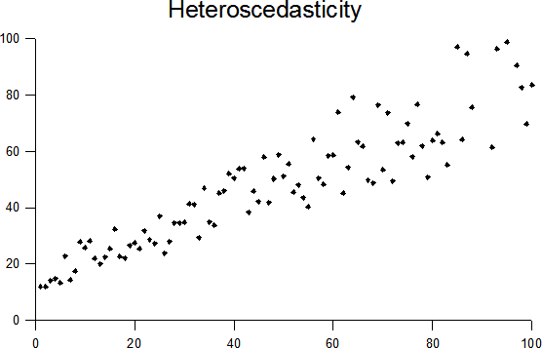
Residual = difference between what the current model gives us and the "right" output
Best approach to minimize the residual depends on your data
ordinary least squares for independent and identically distributed errors
weighted least squares for heteroskedastic errors
(error in y varies with x)
generalized least squares for arbitrary covariance
feasible generalized least squares with autocorrelated errors
(function repeats)
Notes:
https://www.statsmodels.org/stable/regression.html#examples

Slide 46
Residual = difference between what the current model gives us and the "right" output
Best approach to minimize the residual depends on your data
ordinary least squares for independent and identically distributed errors
weighted least squares for heteroskedastic errors
(error in y varies with x)
generalized least squares for correlated residuals
feasible generalized least squares with autocorrelated errors
(function repeats)
Notes:
https://www.statsmodels.org/stable/regression.html#examples
https://en.wikipedia.org/wiki/Ordinary_least_squares

Slide 47
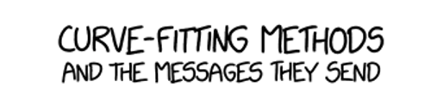
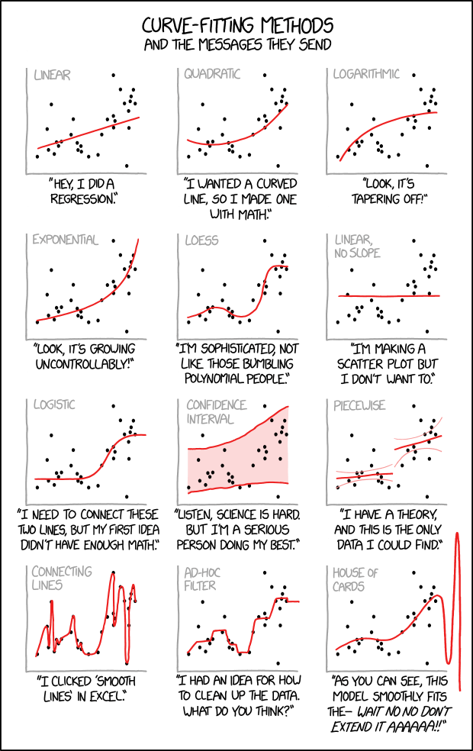
https://xkcd.com/2048

Slide 48
Linear regression = fit data, but for what?
Prediction
Extrapolation = independent variable (x) being evaluated is outside the range of values you already have information on
Interpolation = value you are evaluating is within the range of values you already know
Fitting Trends
Measure Correlation of two variables
Notes:
https://www.quora.com/What-is-the-difference-between-linear-extrapolation-and-linear-regression

Slide 49

Physics experiment: ski jump
Notes:
https://busytoddler.com/2018/01/diy-ball-ramp/

Slide 50
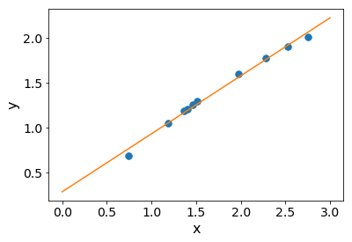
Projectile motion after ball launches
X and Y correlation = 0.996179
Y = 0.64672026*X + 0.28288071
Ball direction
Ramp
ends here
Notes:
https://stats.stackexchange.com/questions/219579/what-is-wrong-with-extrapolation

Slide 51
Projectile motion activity: identify 2 problems
X and Y correlation = 0.996179
Y = 0.64672026*X + 0.28288071
Ball direction
Raise your hand if
you have an observation
Ramp
ends here
Notes:
https://stats.stackexchange.com/questions/219579/what-is-wrong-with-extrapolation

Slide 52
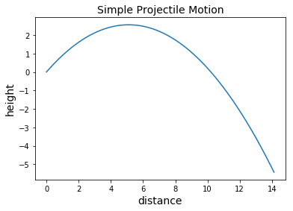
Issues
Insufficient sampling in relevant range
While points within the sampling window are correct, the range of interest is the full arc
Fitting a line to the data appears adequate, but misses the underlying physics of projectile motion: a parabolic path is a second order polynomial

Slide 53
Lesson: Simply trusting data leads to invalid conclusion
Consistently question your data and your own analysis
Investigate how data was collected, by whom, for what purpose
Additional data often helps. Can relevant data be gathered?

Slide 54
statistics emphasizes inference machine learning emphasizes prediction
Statistics: infer the process by which data you have was generated.
Machine learning: predict what future data will look like with respect to some variable.
--> Knowing how the data was generated matters to the story you tell
Notes:
Source:
https://stats.stackexchange.com/questions/6/the-two-cultures-statistics-vs-machine-learning%E2%80%8B
https://projecteuclid.org/euclid.ss/1009213726

Slide 55
When does linear regression apply?
Is the data numerical? (Necessary but not sufficient.)
The stronger the correlation coefficient is,
the more of a linear relationship exists.
Recall from previous lecture
Variance measures width of a distribution
Covariance is the measure of variance for two random variables (joint variability)
Correlation is the normalized covariance, from –1 to 1
Notes:
Source: https://news.ycombinator.com/item?id=9925991
http://connor-johnson.com/2014/02/18/linear-regression-with-python/

Slide 56
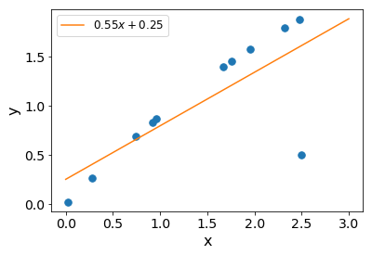
Danger to blindly applying linear regression: Outliers
Correlation without outlier: 0.996
Correlation with outlier: 0.76

Slide 57
Decomposing time series
What is time stamped data?
Why does time stamped data matter?
Data cleanup of time series
Time stamps in Python
Visualization
Decomposing time series
Linear regression for trend analysis
Fourier transform
Homework

Slide 58
Activity: explore and discuss temporal data
Download .pkl and .ipynb from Blackboard > Course materials > Week 8 > texas power data activity
After seeing the solutions shared by instructor, discuss!

Slide 59
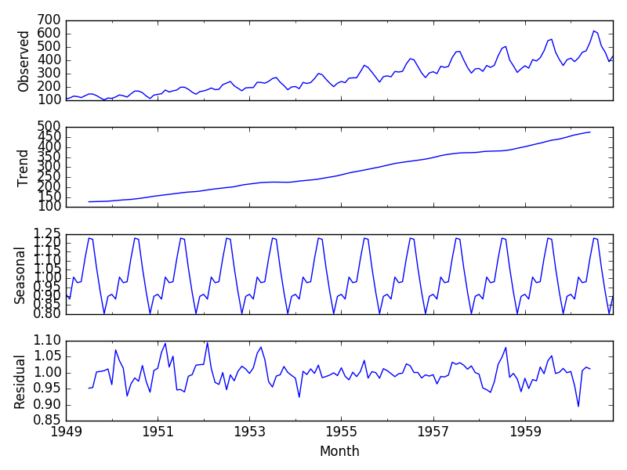
Temporal data has multiple factors present
source
"The Airline Passengers dataset describes the total number of airline passengers over a period of time.
The units are a count of the number of airline passengers in thousands. There are 144 monthly observations from 1949 to 1960."
Notes:
https://machinelearningmastery.com/time-series-trends-in-python/
https://machinelearningmastery.com/decompose-time-series-data-trend-seasonality/

Slide 60
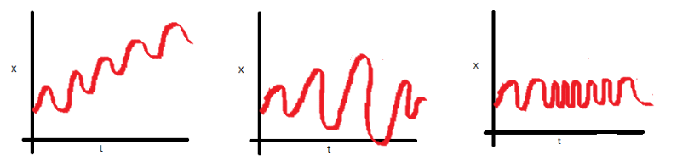
Stationary = mean, variance, covariance, do not vary with time
These three plots demonstrate non-stationary behavior
source
Notes:
https://www.analyticsvidhya.com/blog/2018/09/non-stationary-time-series-python/

Slide 61
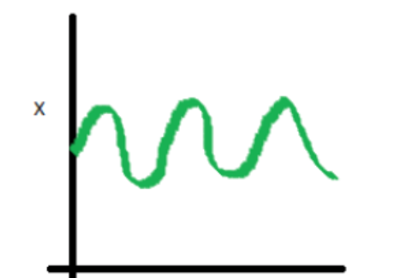
Stationary = mean, variance, covariance, do not vary with time
In this case, the mean, variance and covariance are constant with time. This is what a stationary time series looks like.
source
Notes:
https://www.analyticsvidhya.com/blog/2018/09/non-stationary-time-series-python/

Slide 62
Motivation: decomposing temporal data
Step 1: separate the trend
source
Notes:
https://machinelearningmastery.com/time-series-trends-in-python/
https://machinelearningmastery.com/decompose-time-series-data-trend-seasonality/

Slide 63
Motivation: decomposing temporal data
source
Step 2: separate seasonality
Notes:
https://machinelearningmastery.com/time-series-trends-in-python/

Slide 64
Motivation: decomposing temporal data
source
Notes:
https://machinelearningmastery.com/time-series-trends-in-python/

Slide 65
Example
Data source: historical power load_get_files_make_df.ipynb
Demo: historical_power_df_analysis.ipynb

Slide 66
Methods to decompose temporal data
Trend removal
Differencing
Rolling average
Linear regression
Notes:
https://machinelearningmastery.com/time-series-trends-in-python/

Slide 67
Fourier Transform
What is time stamped data?
Why does time stamped data matter?
Data cleanup of time series
Time stamps in Python
Visualization
Linear regression for trend analysis
Fourier Transform
Homework

Slide 68
Fourier Transform:
FFT only applies to data in which the timestamp is uniform
Demo: fourier_transform.ipynb
Notes:
https://www.ritchievink.com/blog/2017/04/23/understanding-the-fourier-transform-by-example/
https://ipython-books.github.io/101-analyzing-the-frequency-components-of-a-signal-with-a-fast-fourier-transform/
https://gist.github.com/jedludlow/3919130
Animation of FFT: https://plus.maths.org/content/fourier-transforms-images

Slide 69
Homework
What is time stamped data?
Why does time stamped data matter?
Data cleanup of time series
Time stamps in Python
Visualization
Linear regression for trend analysis
Fourier transform
Homework

Slide 70
Check-in activity
Instructor: Randomly assign partners
Talk:
Explain to your partner two things you learned (or confirmed) during this class

Slide 71
How do we know that a function is valid?
Need to specify (and validate) what a function should produce
Tests are not perfect
Demo: doctest.ipynb

Slide 72
Homework 1
convert date-time to day of week
def convert_datetime_to_dayofweek(datetime_string):
"""
>>> convert_datetime_to_dayofweek('Jun 1 2005 1:33PM')
'Wednesday'
>>> convert_datetime_to_dayofweek('Oct 25 2012 2:17AM')
'Thursday'
"""
# your code goes here
return dayofweek
Include citations if you reference websites

Slide 73
Homework 2: Imputation
https://pandas.pydata.org/pandas-docs/stable/user_guide/missing_data.html
Each XLS or XLSX file contains a dataframe.
Load each XLS or XLSX file in your Jupyter notebook.
For each dataframe, address missing values by taking the following steps:
Count the number of missing values in the dataframe; count the number of missing values per column
Plot the distribution of data points using a histogram
Create a lag plot (a lag plot shows t versus t+1)
Based on the lag plot, state in a markdown cell whether the order of this data matters.
Do one of the following (not both):
If the order of the data matters, then interpolate the missing values
If the order of the data does not matter, fill in the missing data by sampling from the distribution
Create a scatter plot using the columns in dataframe; no Nan entries should be present
Submit a single Jupyter notebook with your analysis of the XLS and XLSX files.
Perform interpolation or sampling programmatically using Python (not manually)
https://pandas.pydata.org/pandas-docs/stable/user_guide/visualization.html#visualization-lag
Notes:
<p>Each XLS or XLSX file contains a dataframe. </p>
<p>Load each XLS or XLSX file in your Jupyter notebook. </p>
<p>For each dataframe, address missing values by taking the following steps: </p>
<ol>
<li>Count the number of missing values in the dataframe; count the number of missing values per column </li>
<li>Plot the distribution of data points using a histogram </li>
<li>Create a lag plot (a lag plot shows t versus t-1) </li>
<li>Based on the lag plot, state in a markdown cell whether the order of this data matters. </li>
<li>Do one of the following (not both):
<ul>
<li>If the order of the data matters, then interpolate the missing values </li>
<li>If the order of the data does not matter, fill in the missing data by sampling from the distribution </li>
</ul>
</li>
<li>Create a scatter plot using the columns in dataframe; no Nan entries should be present </li>
</ol>
<p>Submit a single Jupyter notebook with your analysis of the pkl files. </p>
<p>Perform interpolation or sampling programmatically using Python (not manually) </p>

Slide 74
Design your solution to the homework
How will you carry out the required steps?

Slide 75
References
Overview
https://jakevdp.github.io/PythonDataScienceHandbook/03.11-working-with-time-series.html
http://www.statsoft.com/Textbook/Time-Series-Analysis
https://www.itl.nist.gov/div898/handbook/pmc/section4/pmc4.htm
https://pandas.pydata.org/pandas-docs/stable/user_guide/timeseries.html
https://en.wikipedia.org/wiki/Time_series
https://www.kaggle.com/c/demand-forecasting-kernels-only/discussion/63568
https://towardsdatascience.com/basic-time-series-manipulation-with-pandas-4432afee64ea
ARIMA and variants
https://en.wikipedia.org/wiki/Autoregressive_integrated_moving_average https://en.wikipedia.org/wiki/Autoregressive%E2%80%93moving-average_model https://www.quantstart.com/articles/Autoregressive-Integrated-Moving-Average-ARIMA-p-d-q-Models-for-Time-Series-Analysis http://www.blackarbs.com/blog/time-series-analysis-in-python-linear-models-to-garch/11/1/2016 https://machinelearningmastery.com/arima-for-time-series-forecasting-with-python/ https://machinelearningmastery.com/sarima-for-time-series-forecasting-in-python/
https://towardsdatascience.com/playing-with-time-series-data-in-python-959e2485bff8
https://machinelearningmastery.com/make-sample-forecasts-arima-python/
Tactics
https://stackoverflow.com/questions/50161140/how-to-plot-a-time-series-array-with-confidence-intervals-displayed-in-python

Slide 76
Jeffrey Yau: Applied Time Series Econometrics in Python and R | PyData San Francisco 2016
https://www.youtube.com/watch?v=tJ-O3hk1vRw
Aileen Nielsen - Time Series Analysis - PyCon 2017
https://www.youtube.com/watch?v=zmfe2RaX-14
Jordan Kern: Energy Modeling & Analytics- Time Series Analysis
https://www.youtube.com/watch?v=Prpu_U5tKkE
Donald Whyte - High Performance Data Processing in Python
https://www.youtube.com/watch?v=NoJr08FNQeg

Slide 77
Tools I didn't mention in class
https://www.google.com/search?q=facebook+prophet+python https://facebook.github.io/prophet/docs/quick_start.html https://facebook.github.io/prophet/docs/saturating_forecasts.html#forecasting-growth https://facebook.github.io/prophet/docs/trend_changepoints.html#automatic-changepoint-detection-in-prophet
pip install pystan pip install fbprophet

Slide 78
Fourier Transform in Python
https://ericstrong.org/fast-fourier-transforms-in-python/
https://gist.github.com/tartakynov/83f3cd8f44208a1856ce
https://www.oreilly.com/library/view/elegant-scipy/9781491922927/ch04.html
https://docs.scipy.org/doc/scipy/reference/fftpack.html
http://scipy-lectures.org/intro/scipy.html#fast-fourier-transforms-scipy-fftpack
https://docs.scipy.org/doc/scipy/reference/tutorial/fftpack.html

Slide 79
More demos
https://ipython-books.github.io/101-analyzing-the-frequency-components-of-a-signal-with-a-fast-fourier-transform/
https://stackoverflow.com/questions/4479463/using-fourier-analysis-for-time-series-prediction

Slide 80
Additional resources
https://machinelearningmastery.com/decompose-time-series-data-trend-seasonality/ https://stackoverflow.com/questions/47076771/statsmodels-seasonal-decompose-what-is-naive-about-it https://www.statsmodels.org/dev/generated/statsmodels.tsa.stattools.adfuller.html https://machinelearningmastery.com/time-series-data-stationary-python/
https://www.youtube.com/results?search_query=time+series+analysis https://www.youtube.com/watch?v=Prpu_U5tKkE

